Slide 1
Sets and Logic
Quantifiers
Chapter 1
Section 5
Presentation 41
41 Sets and Logic

Slide 2
Propositional Functions
Let P(x) be a statement involving the variable x and let D be a set. We call P a propositional function or predicate (with respect to D) if for each x ∈ D, P(x) is a proposition. We call D the domain of discourse of P.
41 Sets and Logic

Slide 3
Propositional Functions - Example
Let P(n) be the statement:
n is an odd integer
  Then P is a propositional function with domain of discourse Z⁺ since for each n ∈ Z⁺, P(n) is true or false.
Note: A propositional function, by itself, is neither true or false. But for each x in the domain of discourse, P(x) is true or false.
41 Sets and Logic

Slide 4
Propositional Functions - Example
The following are all propositional functions:
  n² + 2n is an odd integer
  (Domain of discourse = Z⁺).
  x² –x – 6 = 0
  (Domain of discourse = R).
  The baseball player hit .300 last year
  (Domain of discourse = baseball players)
41 Sets and Logic

Slide 5
Universally Quantified Statement
Let P be a propositional function with domain of discourse D. The statement:
for every x, P(x)
is said to be a universally quantified statement. The symbol ∀ means “for every”.
Thus the statement for every x, P(x) can be rewritten as ∀x, P(x)
The symbol ∀ is called the universal quantifier.
41 Sets and Logic

Slide 6
Universally Quantified Statement
The statement ∀x, P(x) is true if P(x) is true for every x in D.
The statement ∀x, P(x) is false if P(x) is false for at least one x in D.
A value x in the domain of discourse that makes P(x) false is called a counterexample.
41 Sets and Logic

Slide 7
Universally Quantified Statement
Example
Consider the universally quantified statement
∀x, (x² > 0) with domain of discourse R.
The statement true because, for every real number x, x² is greater than or equal to 0
41 Sets and Logic

Slide 8
Universally Quantified Statement
Example
Consider the universally quantified statement
∀x, (x² – 1 > 0)
with domain of discourse R.
The statement false because, if x = 1,
then x² – 1 = 1² – 1 = 0 which is not > 0.
The value 1 is a counter example.
41 Sets and Logic

Slide 9
Universally Quantified Statement
Example
Suppose P is a propositional function whose domain of discourse is the set {d₁, d₂, …d_{n}}.
The following pseudo code determines whether ∀x, P(x) is true or false.
for i = 1 to n
if (¬P(d_{i}))
return false
return true
41 Sets and Logic

Slide 10
Universally Quantified Statement
Example
Alternate ways to write ∀x.
For all x, P(x)
For any x, P(x)
For every x, P(x)
41 Sets and Logic

Slide 11
Existentially Quantified Statement
Let P be a propositional function with domain of discourse D. The statement:
there exist x, P(x)
is said to be a existentially quantified statement. The symbol ∃ means “there exist”.
Thus the statement for there exist an x, P(x) can be rewritten as ∃x, P(x)
The symbol ∃ is called the existentially quantifier.
41 Sets and Logic

Slide 12
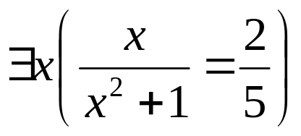
Existentially Quantified Statement
Example
Consider the existentially quantified statement
The domain of discourse is R. The statement is true because there exists at least one real number for which the proposition is true.
(x = 2)
41 Sets and Logic

Slide 13
Existentially Quantified Statement
Example
Suppose P is a propositional function whose domain of discourse is the set {d₁, d₂, …d_{n}}.
The following pseudo code determines whether ∃x, P(x) is true or false.
for i = 1 to n
if (P(d_{i}))
return true
return false
41 Sets and Logic

Slide 14
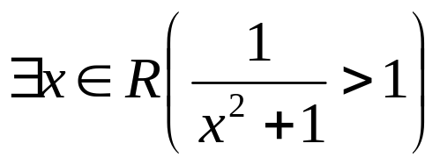
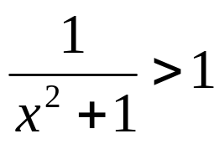
Existentially Quantified Statement
Example
To verify the existentially qualified statement
is false, we must show that
is false for every real number x.
41 Sets and Logic

Slide 15
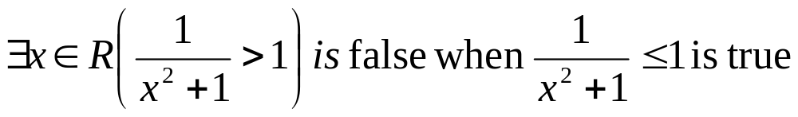
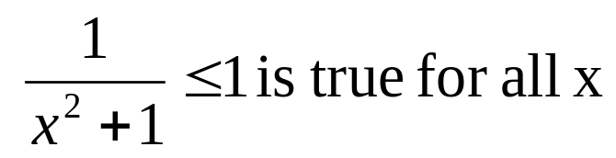
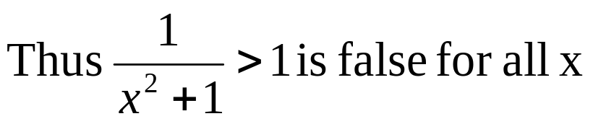
Existentially Quantified Statement
Example
Since 0 < x², we may add one to both sides
1 < x²+1
Divide both sides by x²+1 to obtain
41 Sets and Logic

Slide 16
Existentially Quantified Statement
Example
Consider the existentially quantified statement
for some n, if n is prime, then n+1, n+2, n+3 and n+4 are NOT prime.
For example, if n =23, then 24, 25, 26 and 27 are NOT prime, therefore the statement is true.
41 Sets and Logic

Slide 17
Generalized DeMorgan’s Law
The following propositional functions have the same truth values (either both are true or both are false)
  ¬(∀x P(x)) and ∃x ¬P(x)
    ¬( P₁∧P₂∧ … ∧ P_{n})=¬P₁∨ ¬ P₂ ∨ … ∨¬ P_{n}
  ¬(∃x ¬P(x)) and ∀ x ¬P(x)
    ¬( P₁∨P₂∨ … ∨P_{n})=¬P₁∧ ¬ P₂∧ … ∧¬ P_{n}
41 Sets and Logic

Slide 18
Generalized DeMorgan’s Law
Example
Negate the following
  ∀x (x² + 1 > 1)
  using the fact: ¬(∀x P(x)) ≡ ∃x ¬P(x)
    ¬(∀x (x² + 1 > 1)) = ∃x (x² + 1 < 1)
  ∃x (x² - 1 = 0)
  using the fact ¬(∃x P(x)) ≡ ∀x ¬P(x)
    ¬(∃ x (x² - 1 = 0)) = ∀x (x² - 1 ≠ 0)
41 Sets and Logic

Slide 19
Generalized DeMorgan’s Law
Examples
Write the statement symbolically, write its negation and write the negation in words
  Every music fan loves The Beatles
  Let P(x) be the propositional function “x loves music”. The statement can be written as ∀ x P(x)
  The domain of discourse is all music lovers
  The negation of ∀ x P(x) is ¬(∀ x P(x))
  and by by DeMorgan’s law, ¬(∀ x P(x)) is equivalent to ¬ ¬(∃x ¬P(x)) = (∃x ¬P(x))
  In words – there is a music fan who does NOT love The Beatles
41 Sets and Logic

Slide 20
Generalized DeMorgan’s Law
Examples
Write the statement symbolically, write its negation and write the negation in words
  Some birds cannot fly
  Let P(x) be the propositional function “x flies”. The statement can be written as ∃x ¬P(x)
  The domain of discourse is all birds
  The negation of ∃x ¬P(x) is ¬(∃x ¬P(x))
  and by by DeMorgan’s law, ¬(∃x ¬P(x)) is equivalent to (∀ x ¬ ¬ P(x)) = (∀ x P(x))
  In words – Every bird can fly
41 Sets and Logic

Slide 21
Homework - Day 1
Yes there is a day 2
YES, YOU MUST WRITE OUT THE PROBLEM
Due tomorrow
  Review Exercises
    Page 50 # 1- 6all
  Exercise
    Page 50 # 1-27 odd
Quizzes are now fair game
41 Sets and Logic

Slide 22
Homework - Day 2
Yes there is a day 3
YES, YOU MUST WRITE OUT THE PROBLEM
Due tomorrow
  Review Exercises
    Page 50 # 7 – 10 all
  Exercise
    Page 50 # 29 - 47 odd
    note # 43 – negate 35-41 odd
Quizzes are now fair game
41 Sets and Logic

Slide 23
Homework - Day 3
There is No day 4
YES, YOU MUST WRITE OUT THE PROBLEM
Due tomorrow
  Exercise
    Page 50 # 49 – 56 all
Quizzes are now fair game
41 Sets and Logic

